Slide 1
Analysis of AirBnB Prices
By: Jacob Stys

Slide 2
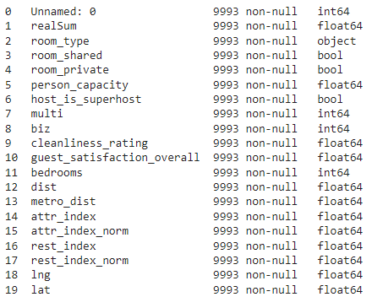

Introduction
Link to Dataset: https://www.kaggle.com/datasets/thedevastator/airbnb-prices-in-european-cities
The Dataset is a sample of AirBnB stays in the city of London for weekends and weekdays.
List of Variables:
Almost 10000 samples.

Slide 3
Purpose
The purpose of this project is to give recommendations on what is the best way to save money for traveling to the city of London through AirBnB.
Variables like dist (Distance to City Center Kilometers) is the variable of interest we are going to test.
We want to test if the price of an AirBnB stay will change based on how far from the city center the stay is.
Combining this with uber prices can be a great way to plan a trip while being on a budget although further analysis will be required.

Slide 4
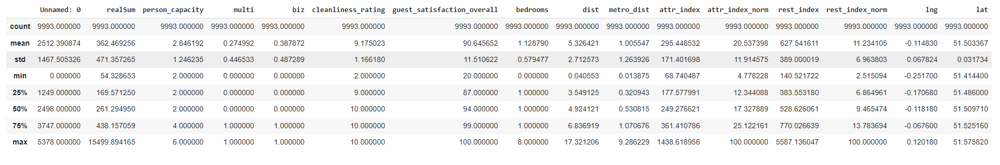
Descriptive Statistics and Cleansing
Describe the Data:
Created three data frames where group A had dist between 0 and 3 kilometers, group B dist had 3 to 6 kilometers, and group C had 6 or more kilometers.
Each frame had over 1000 samples in each so the effect size is sufficient.

Slide 5
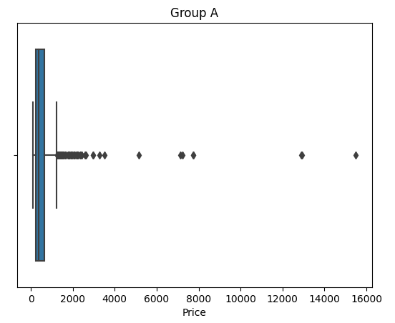
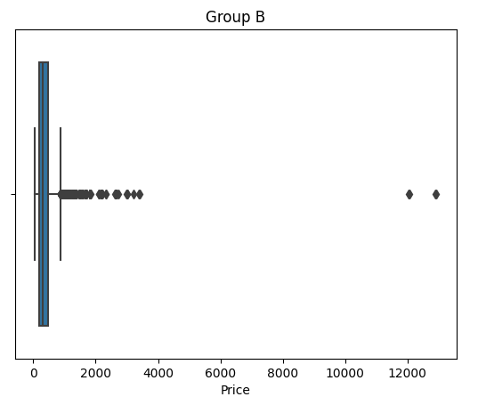
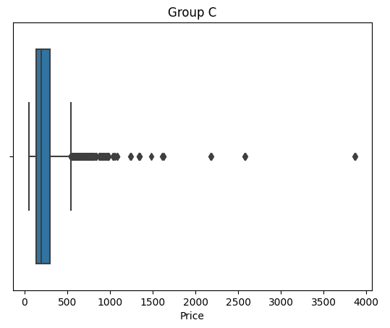
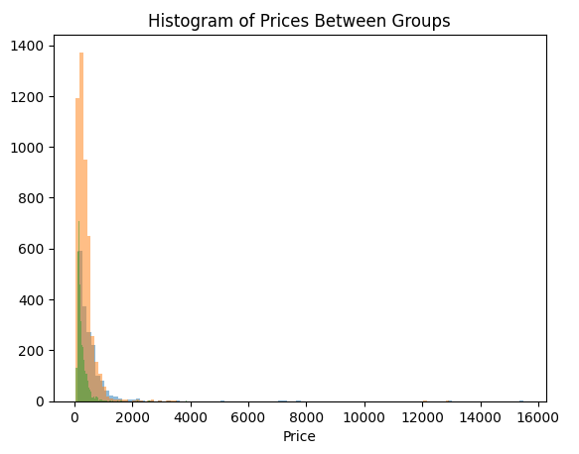
Box-Plot and Histogram between Groups
Plots show a right skew of each of the plots so running a
Non-parametric Test such as Kruskal Wallis will be performed.

Slide 6
Analysis
Group A CI:
Group B CI:
Group C CI:
Analysis shows that there is a significant difference in price by how far or how close an airbnb stay is to the city center in London.

Slide 7
Price Difference
The price difference is significant between each group.
When planning a vacation to London considering the distance to the city center should be considered as a variable that affects the price of the AirBnB stay.
Analyzing uber prices could help for being on a budget when traveling to London and could result in a cheaper less expensive visit to London.

Slide 8
Questions?

Slide 9
Thanks!

